Slide 2
MAS512 Assignment 2
Group 6: Bjørn Sødal

Slide 3
Question 1
Part A:
Find 3D coordinates of centre of swinging load in all frames of video using M_{int}
Plot the 3D coordinates of every frame
Part B:
Use default intrinsic matrix to find center of swinging load and plot those coordinates.
Part C:
Which one of these coordinates are most accurate?
Part D:
Implement ML that learns function parameters such that f𝜃(o₁) = o₂*
Part E:
Find Euclidean error between the two coordinate plots, make interpretations of results

Slide 4
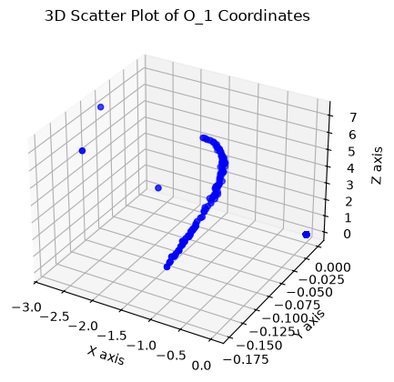
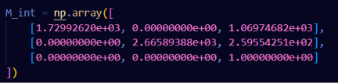
Q1 A
According to these plots, box is largely
located to the upper left of the camera frame.
Majority of center coords are 0, thus
large amount of (0,0,0) readings.
P^{p} = M_{int}*P^{c} => P^{c} = M_{int}⁻¹ * P^{p}

Slide 5
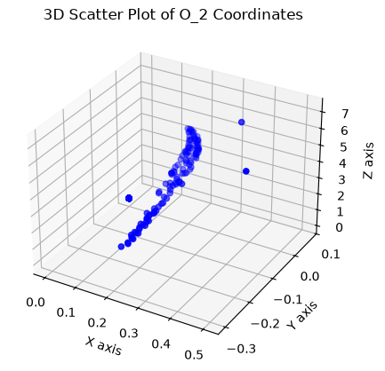
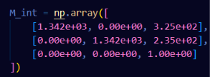
Q1 B
With standard matrix the perspective shifts
completely to where the vast
majority of points are located in
upper right, which is more accurate to
what we see in video.

Slide 6
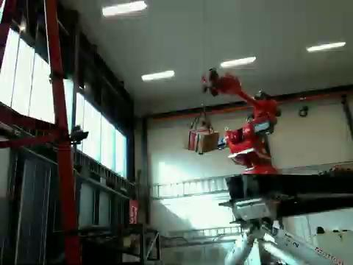

Slide 7

Q1 C
So which one is more accurate?
Clearly the standard
matrix is more accurate.

Slide 8
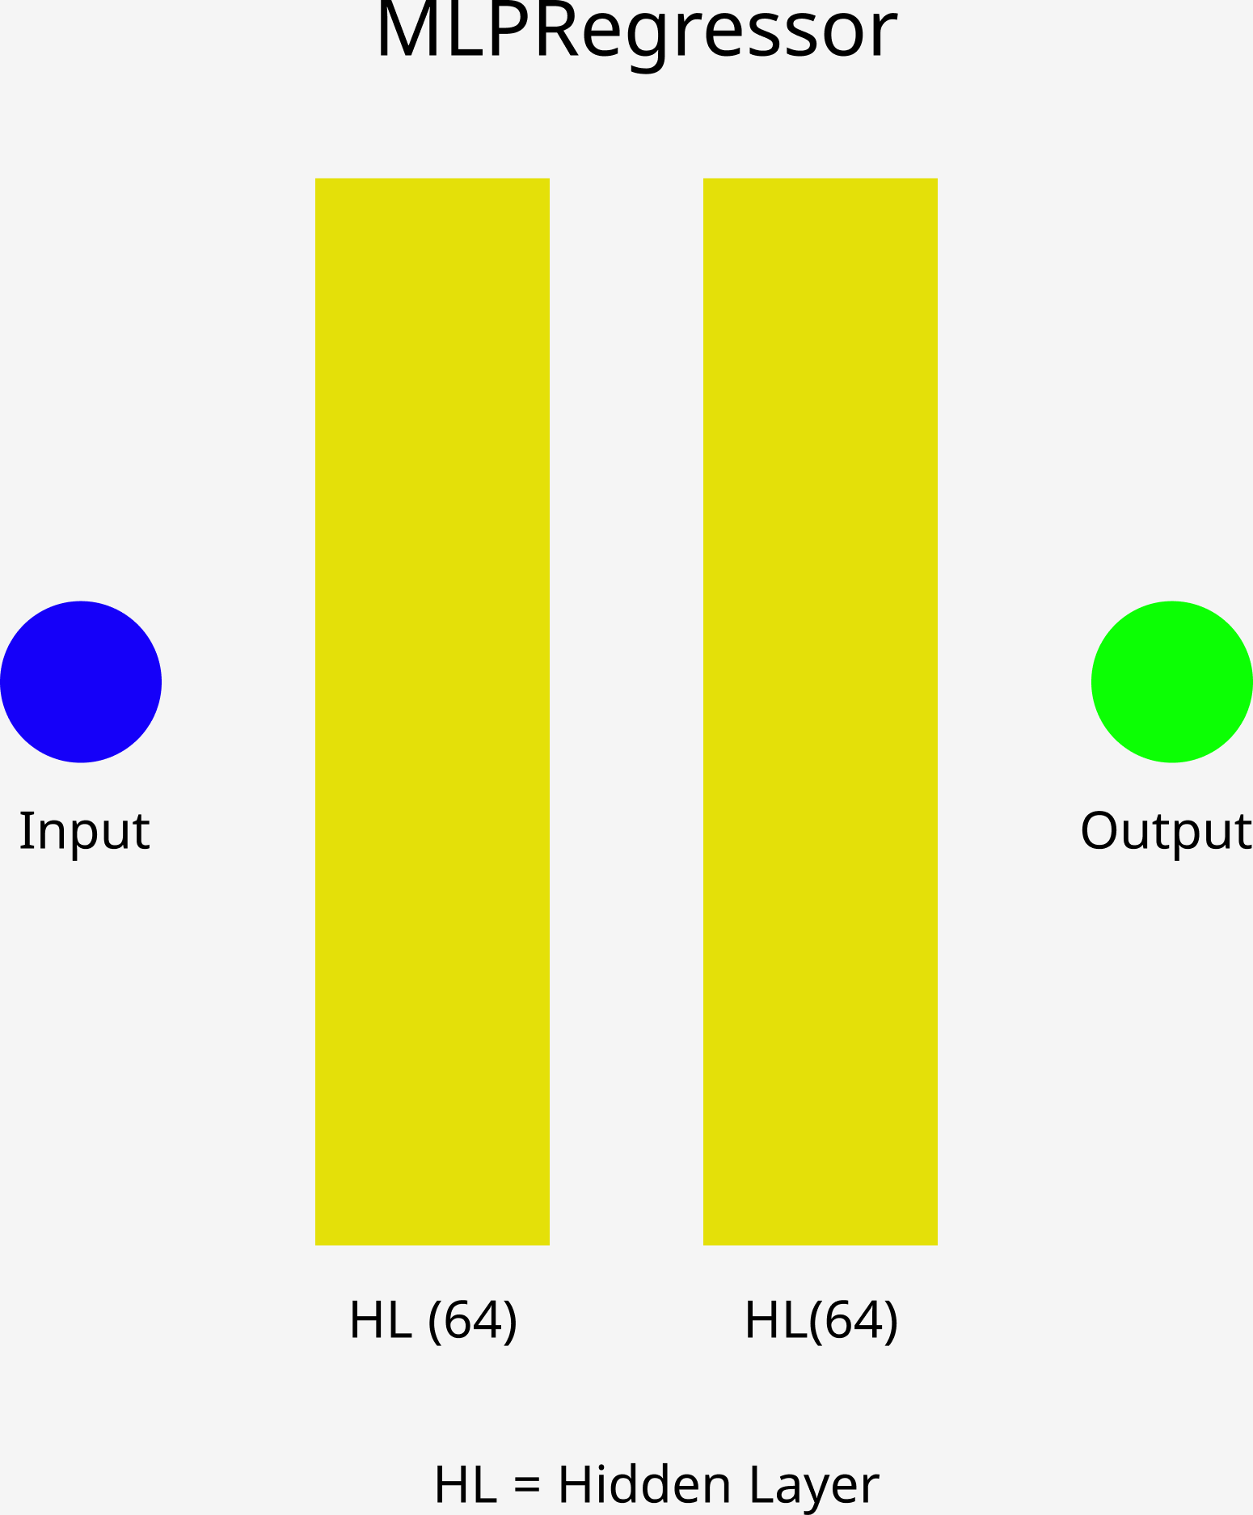

Q1 D
Split O₁ and O₂ into 80-20 train-test.
Fit scikit-learn MLPRegressor to O₁ and O₂ train.
Test model on O₁ test to get inferred O₂*.
https://scikit-learn.org/stable/modules/generated/sklearn.neural_network.MLPRegressor.html

Slide 9
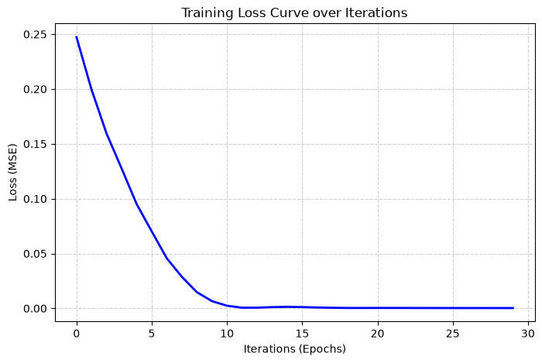

Slide 10
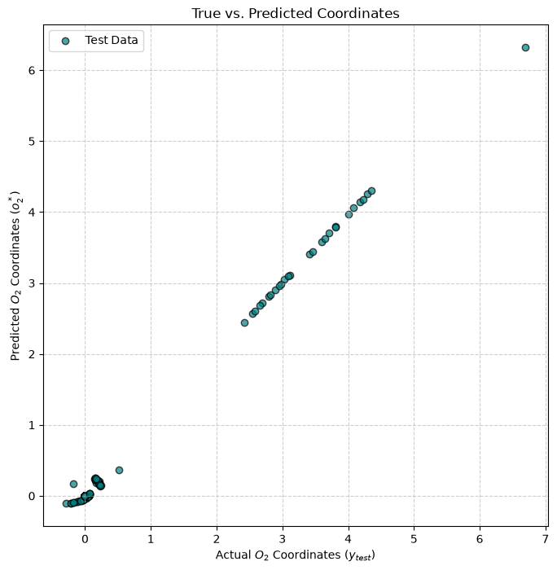

Slide 11
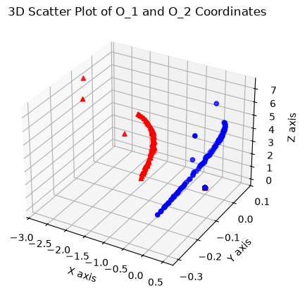
Q1 E (i)
Mean Euclidean Error = 0.2107 meters
Root Mean Square Error = 0.5683 meters

Slide 12
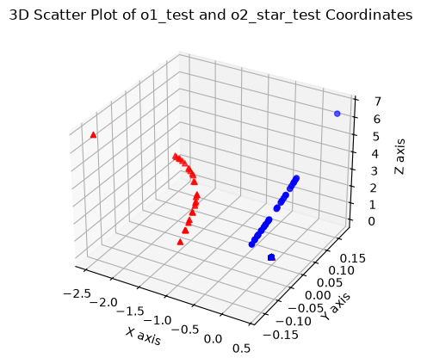
Q1 E (ii)
Mean Euclidean Error = 0.2325 meters
Root Mean Square Error = 0.6165 meters
Similar errors, but larger discrepancies
likely due to smaller amount of points
in test set than complete sets:
0.20 * 900 = 180

Slide 13
Question 2
Part A
Find center of swinging load in point cloud
Track center point
Plot center point for all frames
Part B
Use KISS ICP to find pose of load in consecutive lidar frame

Slide 14
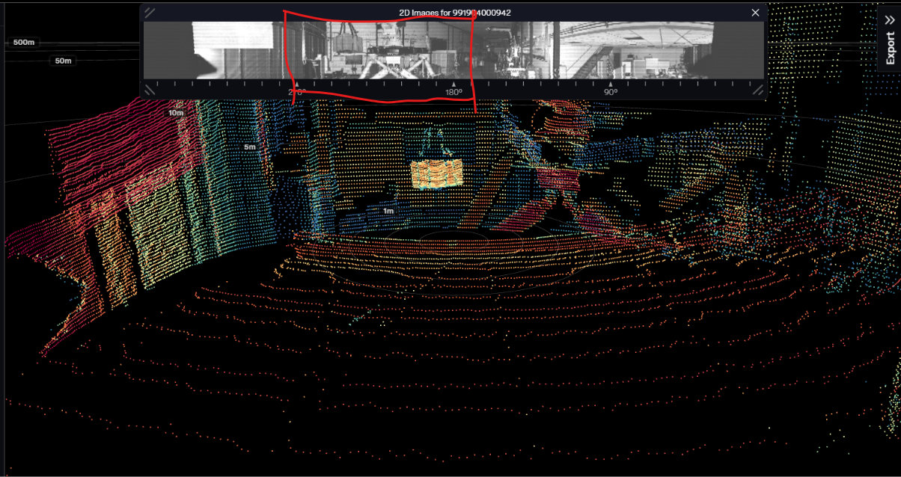
Q2 A
Box is always within 180º - 270º.
Filter away all points outside
this range.
Check which points have a
changing depth value frame-to-
frame, arrange all points in
sequential array, median index
point is center.
Plot this center point for all frames.

Slide 15
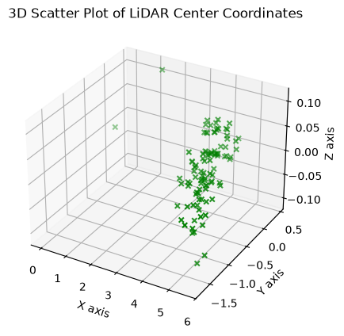
Possible alternative method would
be to extract reflectivity and
train new yolo model on box
then get center coords from that
bounding box.
I’m too lazy to annotate more images.
Mean over median could make
estimations more concentrated
though skewed.
https://ouster.com/insights/blog/object-detection-and-tracking-using-deep-learning-and-ouster-python-sdk

Slide 16
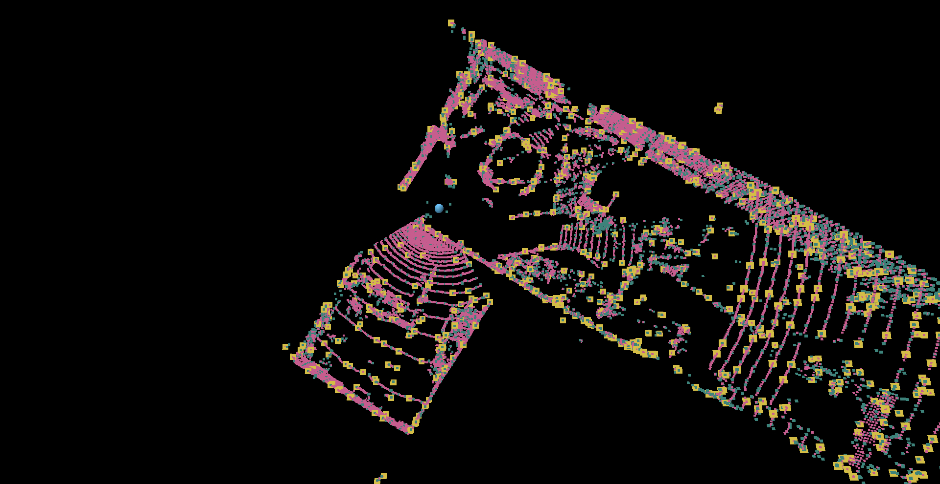
Q2 B
Did not understand what the question was asking of me to do. Dropped.

Slide 17
Question 3
Part A
Get familiar with KITTI dataset
Part B
Utilize camera-lidar fusion
Perform:
Projection
Detection
Evaluation

Slide 18
Q3 A
The KITTI (Karlsruhe Institute of Technology and Toyota Technological Institute ) dataset is comprised of various sensor data collected from a moving vehicle used for model benchmarking for autonomous vehicles.
Captured on a VW station wagon outfitted with high quality camera, LiDAR and GPS. Contains over 6 hours of captured data, with for example ground truths for depth estimations through bounding boxes for object detection.
Our dataset is KITTI 3D Object Detection Dataset For PointPillars Algorithm by GaryMK:
https://www.kaggle.com/datasets/garymk/kitti-3d-object-detection-dataset

Slide 19
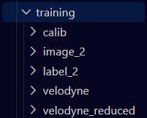
Training dataset is broken down into 5 directories,
echo containing a file of xxxxxx.<file> template,
specific to each folder type:
calib -> .txt
image_2 -> .png
label_2 -> .txt
velodyne -> .bin
velodyne_reduced -> .bin

Slide 20
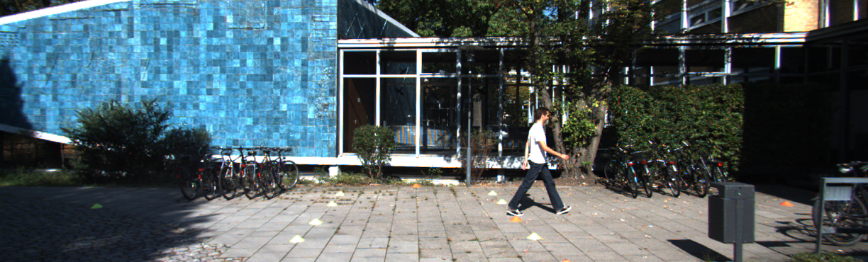
Image

Slide 21
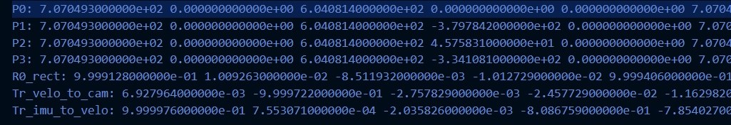
Calibration

Slide 22
Label
Can’t show raw binaries (obviously), but you get the idea. We project LiDAR data on top of images using Calibration, and use Label for ground truth.

Slide 23
Q3 B
Calibration files and label files are of greatest interest for fusion. Allows for projection and “overlays” of LiDAR data on top of image data and then estimation of depth through median depth averaging of LiDAR points within ground truth bounding box (same approach as Q2A but now with given bounding boxes).
Use label 3D bounding box as ground truth for depth and position of ROI and compare versus LiDAR points within said box.

Slide 24
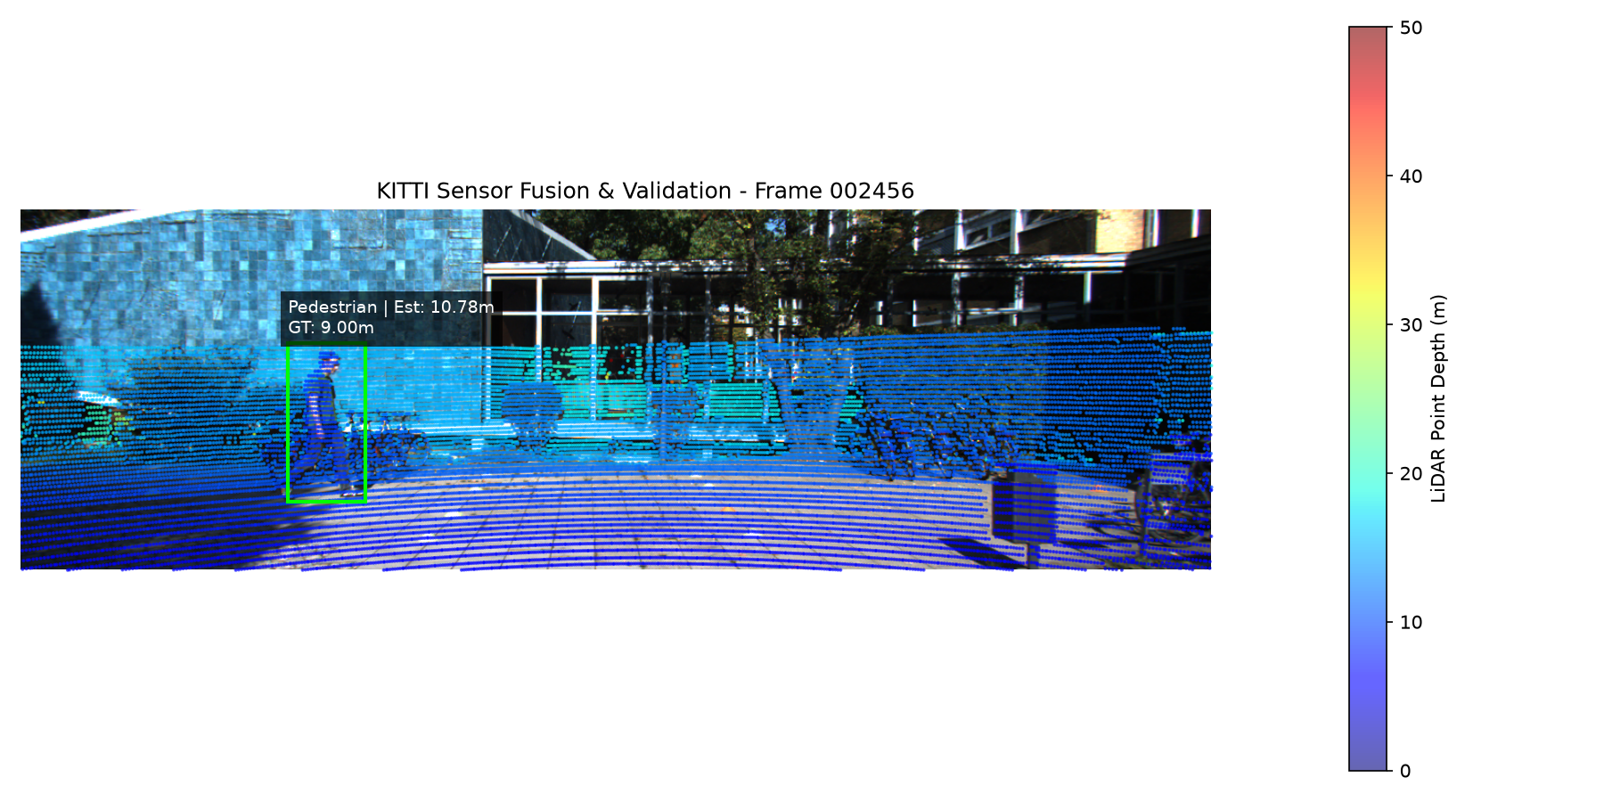

Slide 25
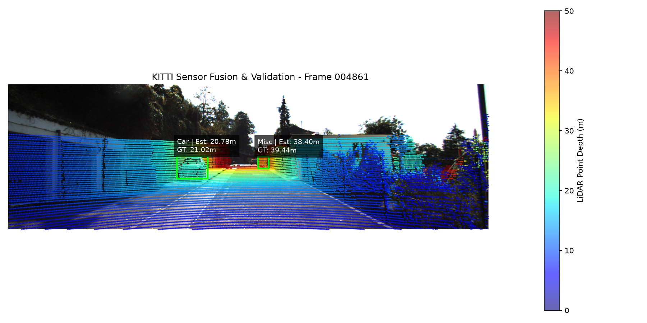

Slide 26
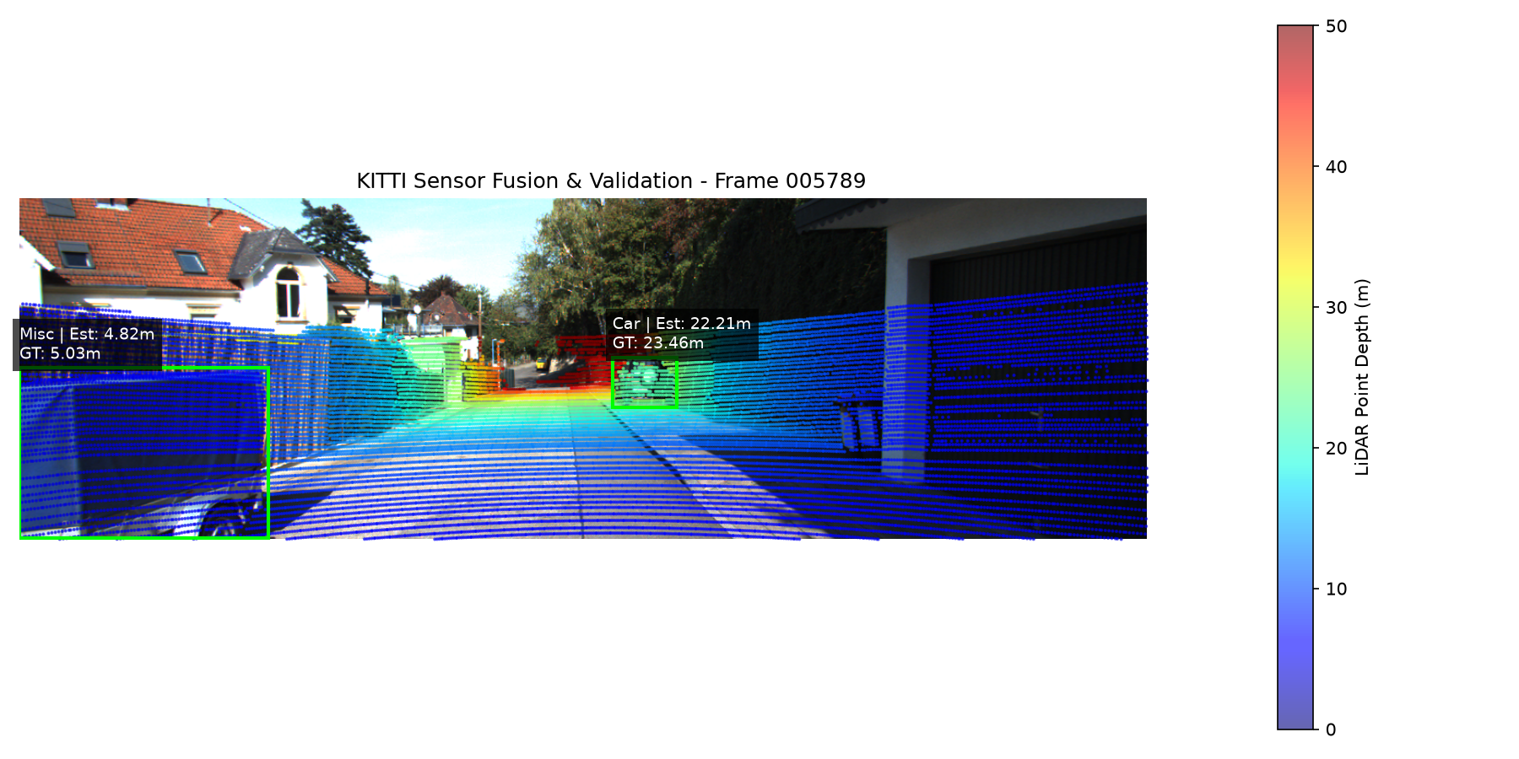

Slide 27
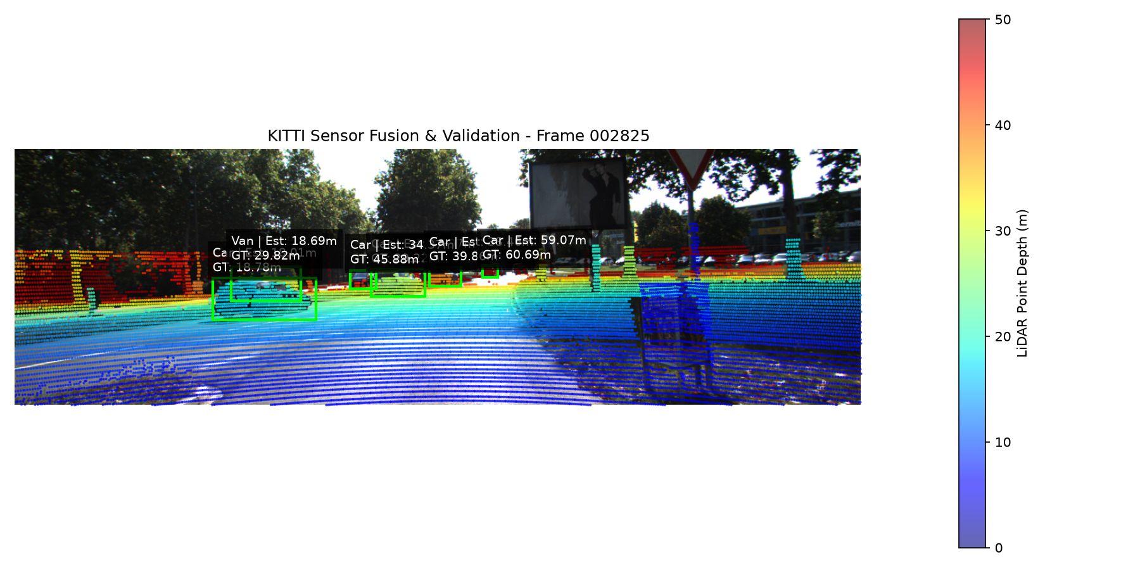

Slide 28
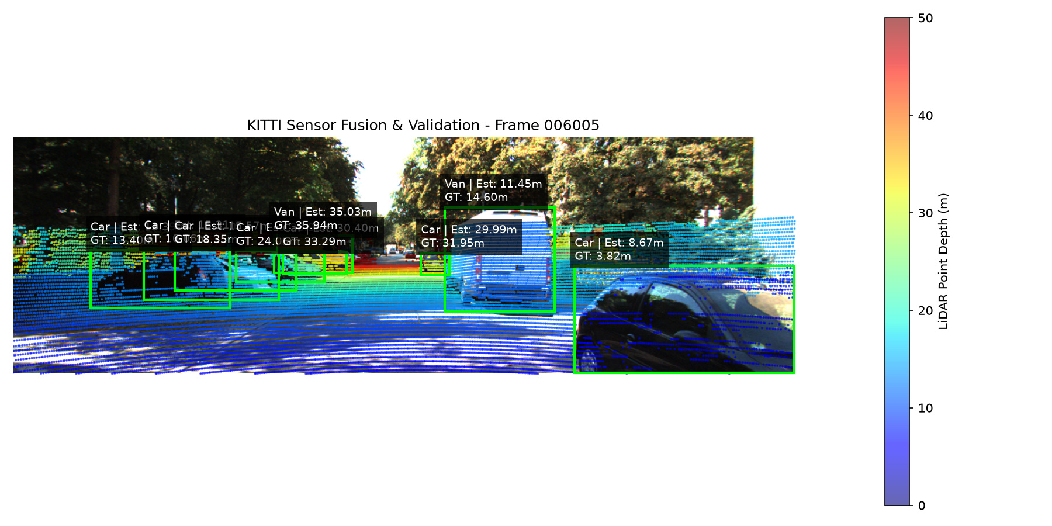

Slide 29
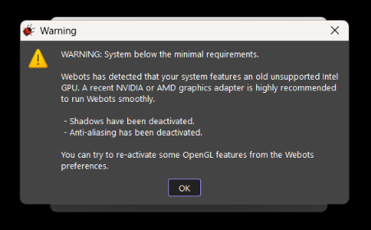
Question 4
Uh oh :(

Slide 30
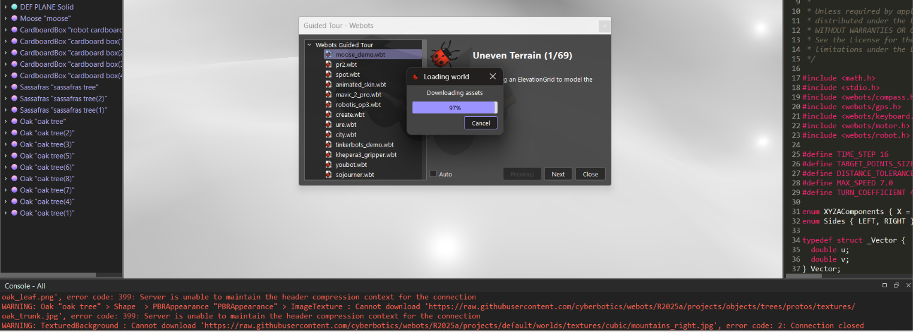
Frozen, cannot perform task

Slide 31
References
Repository: https://github.com/BjarkanDev/MAS512

